Slide 1
What is a Software and Types of Software

Slide 2
What is Software?
Software is a collection of instructions, data, or computer programs that are used to run machines and carry out particular activities.

Slide 3
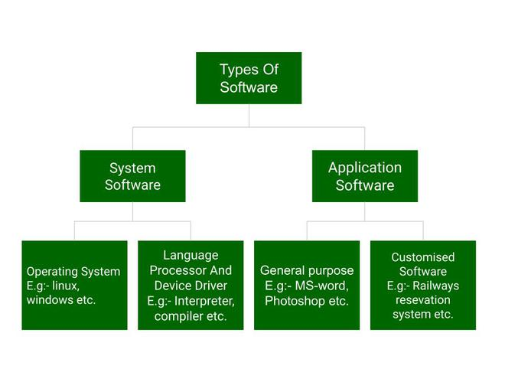
Types of Software
It is a collection of data that is given to the computer to complete a particular task. The chart below describes the types of software:

Slide 4
Types of Software
System Software
Operating System
Language Processor
Device Driver
Application Software
General Purpose Software
Customize Software
Utility Software

Slide 5
System Software
System software is software that directly operates the computer hardware and provides the basic functionality to the users as well as to the other software to operate smoothly. Or in other words, system software basically controls a computer’s internal functioning and also controls hardware devices such as monitors, printers, and storage devices, etc.

Slide 6
Type of System Software
Operating System: It is the main program of a computer system. When the computer system ON it is the first software that loads into the computer’s memory. Basically, it manages all the resources such as computer , memory, CPU, Printer , hard disk, etc., and provides an interface to the user, which helps the user to interact with the computer system.

Slide 7
Type of System Software
Language Processor: As we know that system software converts the human-readable language into a machine language and vice versa. So, the conversion is done by the language processor.

Slide 8
Type of System Software
Device Driver: A device driver is a program or software that controls a device and helps that device to perform its functions. Every device like a printer, mouse, Modem ,etc. needs a driver to connect with the computer system eternally.

Slide 9
Application Software
Application Software that performs special functions or provides functions that are much more than the basic operation of the computer is known as application software . Or in other words, application software is designed to perform a specific task for end-users. It is a product or a program that is designed only to fulfill end-users’ requirements.

Slide 10
Types of Application Software
General Purpose Software: This type of application software is used for a variety of tasks and it is not limited to performing a specific task only. For example, MS-Word, MS-Excel, PowerPoint, etc.
Customized Software: This type of application software is used or designed to perform specific tasks or functions or designed for specific organizations. For example, railway reservation system, airline reservation system, invoice management system, etc.

Slide 11
Types of Application Software
Utility Software: This type of application software is used to support the computer infrastructure. It is designed to analyze, configure, optimize and maintains the system, and take care of its requirements as well. For example, antivirus, disk fragmenter, memory tester, disk repair, disk cleaners, registry cleaners, disk space analyzer, etc.

